Slide 1

UNIT - 3 INTRODUCTION TO LINKED LISTS

Slide 2
Outcome
Using this linked lists topic student can able understand linked lists, representation, advantages, applications.

Slide 3
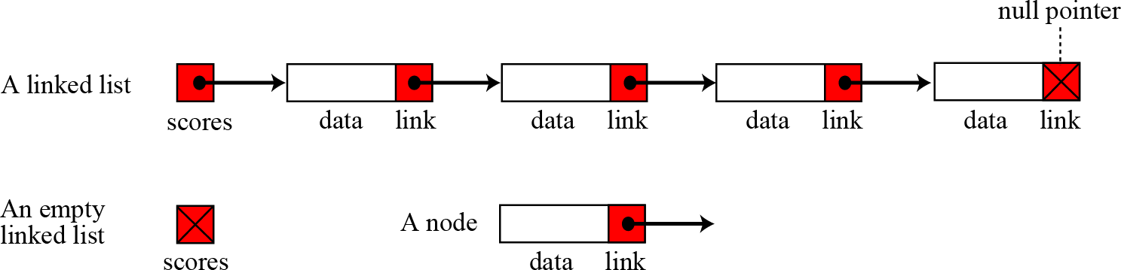
Introduction to Linked List
A linked list is a collection of data in which each
element contains
the location each element
of the next
two
element—that is,
contains
parts: data and link.
3

Slide 4
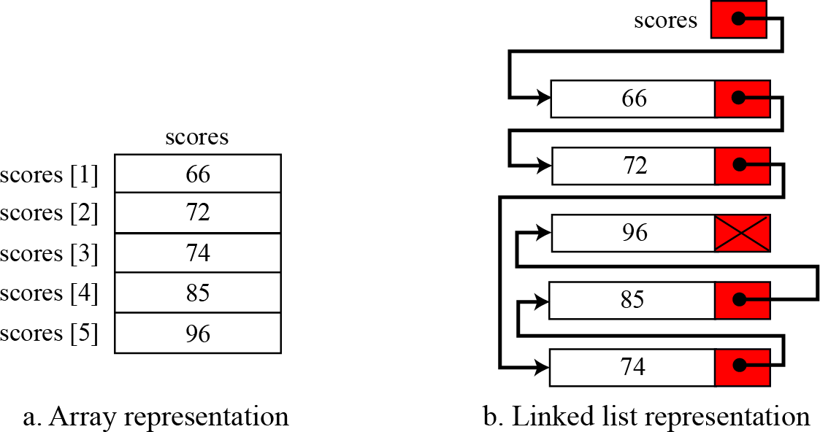
Arrays versus Linked Lists
Both an array and a linked list are representations of a list of items in memory. The only difference is the way in which the items are linked together. The Figure below compares the two representations for a list of five integers.
4

Slide 5
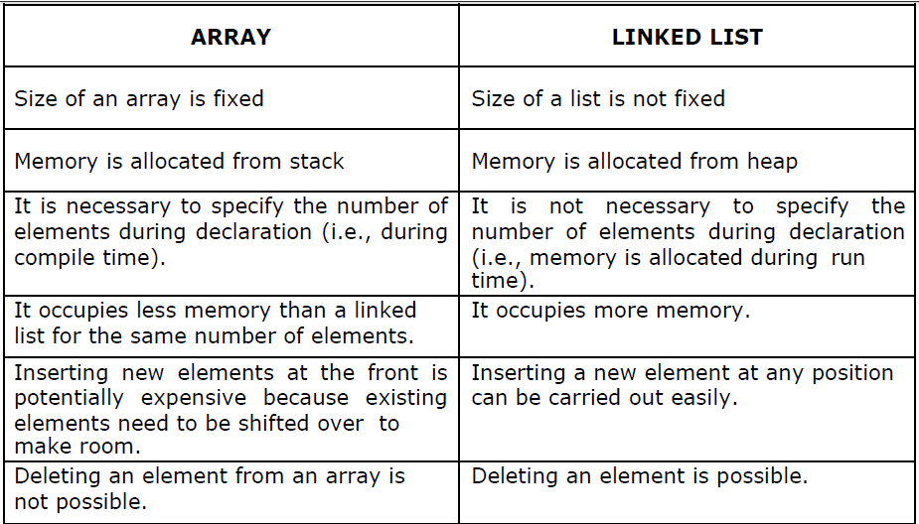

Slide 6
Linked List: A Dynamic Data Structure
A data structure that can shrink or grow during program execution.
The size of a dynamic data structure is not necessarily known at compilation time, in most programming languages.
Efficient insertion and deletion of elements.
The data in a dynamic data structure can be stored in non-contiguous (arbitrary) locations.
Linked list is an example of a dynamic data structure.
6

Slide 7
Advantages of linked list
1. Linked lists are dynamic data structures. i.e., they can grow or shrink during the execution of a program.
2. Linked lists have efficient memory utilization. Here, memory is not pre- allocated.
3. Memory is allocated whenever it is required and it is de-allocated (removed) when it is no longer needed.
4. Insertion and Deletions are easier and efficient.
6. Many complex applications can be easily carried out with linked lists.
7

Slide 8
Disadvantages
Disadvantages of linked lists:
1. It consumes more space because every node requires a additional pointer to store address of the next node.
2. Searching a particular element in list is difficult and also time consuming.

Slide 9
Applications of linked list
Linked lists are used to represent and manipulate polynomial. Polynomials are expression containing terms with non zero coefficient and exponents. For example:
P(x) = a₀ X^{n} + a₁ X^{n-1} + …… + a_{n-1} X + a_{n}
Represent very large numbers and operations of the large number such as addition, multiplication and division.
Linked lists are to implement stack, queue, trees and graphs.
Implement the symbol table in compiler construction.
9

Slide 10
Types of linked lists
Single linked list
Circular single linked list
Doubly linked list
Circular double linked list
10

Slide 11
Quiz (Answer in chat)
1. Which among the following is a Dynamic data structure:
A. Linked List
B.Stack
C.Queue
D. all the above
2. Which among the following is a linear data structure:
Queue
Stack
Linked List
All The Above
3. The link field in a node contains:
address of the next node
data of previous node
data of next node
data of current node
4. Memory is allocated dynamically to a data structure during execution by function.
malloc()
Calloc()
realloc()
all the above

